Slide 1
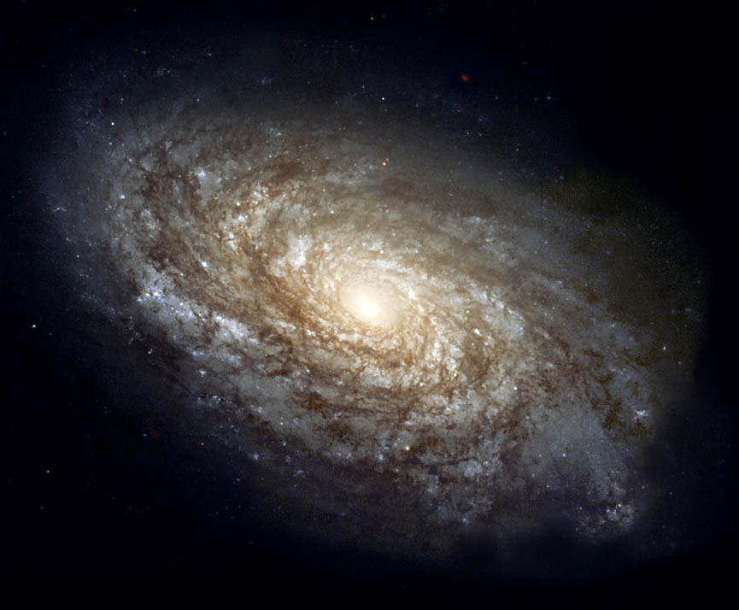
A. Earth’s Galaxy—and Others
Galaxy: A large group of stars, gas, and dust held together by gravity.
Milky Way: Our galaxy which contains about 200 billion stars and many nebulas
Spiral Galaxies

Slide 2
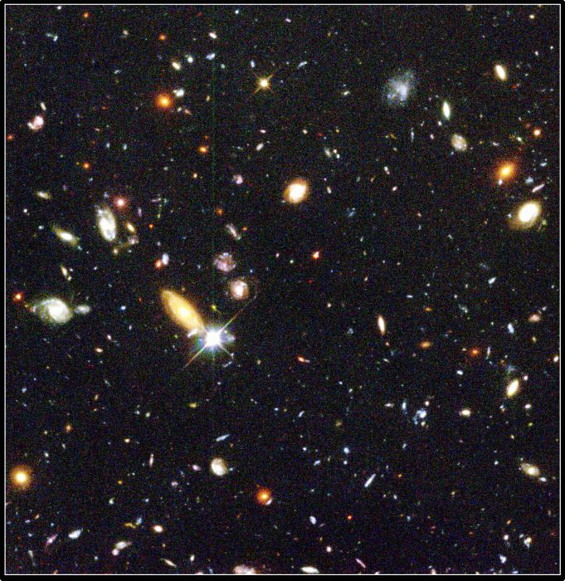
A. Earth’s Galaxy—and Others
Galaxies are grouped together in clusters.
The cluster the Milky Way belongs to is called the Local Group.
Three types of galaxies:
Cluster of galaxies

Slide 3
Elliptical Galaxies
Elliptical Galaxies: Most common type of galaxy; large three-dimensional football shaped galaxies.
-Contain mostly older and dimmer stars.

Slide 4
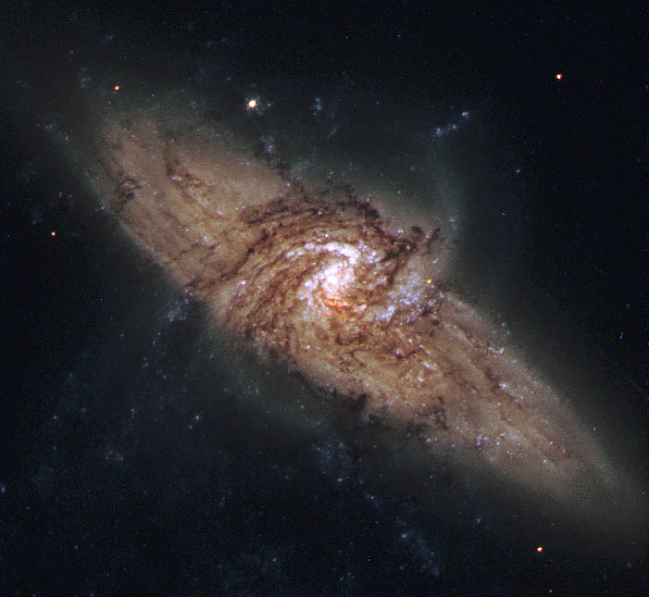
Spiral Galaxies
Spiral Galaxies: Circular galaxies that have arms curve outward from a central hub.
Arms are made up of stars and dust
Two spiral galaxies!!

Slide 5
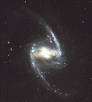
More Spiral Galaxies
Barred spiral galaxies: Have two spiral arms extending out.

Slide 6
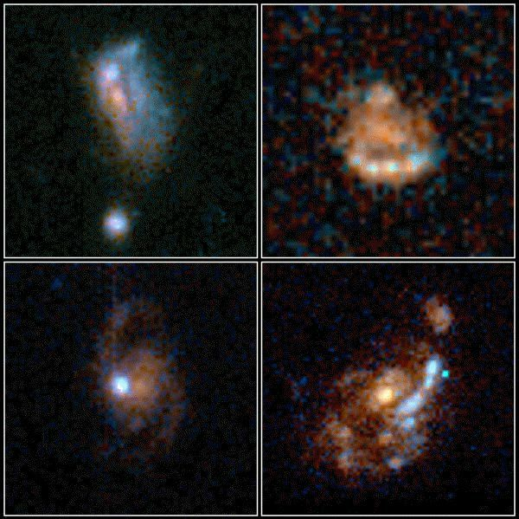
Irregular Galaxies
Irregular Galaxies: Come in many different shapes and are smaller and less common than elliptical or spiral galaxies.

Slide 7
B. The Milky Way Galaxy
100,000 light years in diameter
Our sun orbits the center of the galaxy once every 240 million years
Probably a barred spiral galaxy
Contains over 200 billion stars
Its where I live!!!!!

Slide 8
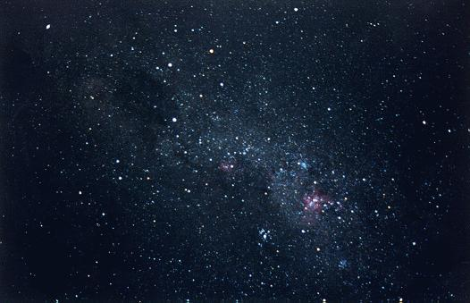
Stars
Star: A hot glowing sphere of gas that produces energy by fusion.
Fusion: The joining of separate nuclei. Common in nature, but not on Earth.

Slide 9
Hydrogen Fusion: Energy of the Stars
Stars have large amounts of hydrogen gas.
Four hydrogen atoms fuse forming 1 atom of helium
The mass of 4 hydrogen atoms is greater than the mass of 1 helium atom; the excess mass is converted to a tremendous amount of energy.

Slide 10
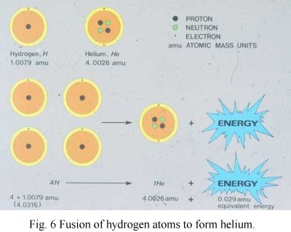
This hydrogen → helium fusion can power a star for billions of years

Slide 11
Absolute vs. Apparent Magnitude of Brightness
Variables which affect a star’s brightness:
Star size
Distance from Earth
Temperature
Apparent Brightness:
The amount of light received on Earth from a star.
Absolute Brightness: The amount of light received from a star if it were 33 ly away from Earth.

Slide 12
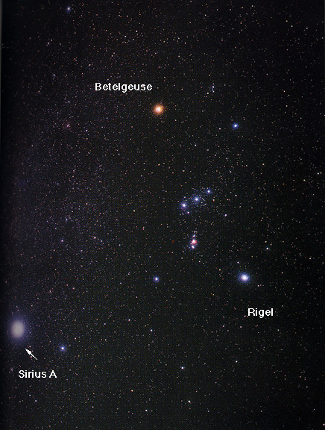
Star Brightness
Example: (Fig. 20.1) Sirius has a greater apparent brightness then Rigel, even though Rigel is a much hotter and brighter star.
Why?

Slide 13
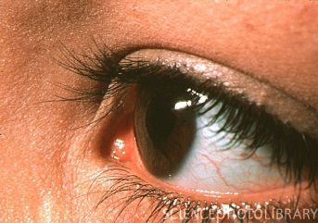
Apparent Brightness
200 m
If the same kind of
flashlights are used,
which would look
brighter?
2 m

Slide 14
3 Categories of Stars
Low Mass
Medium Mass→ Our Sun is in this category
High Mass

Slide 15
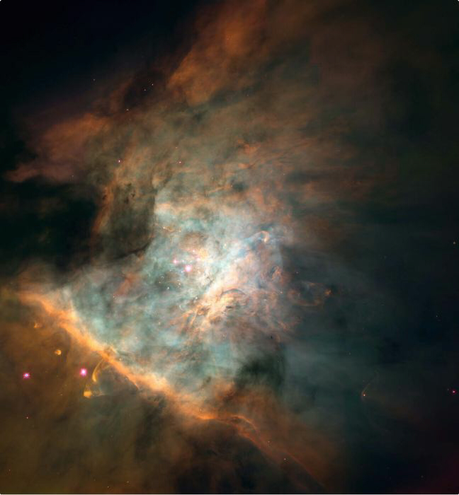
The origin of Stars
Nebula: A large cloud of gas (helium and hydrogen) and dust which forms into a star.
Dust and gas particles exert a gravitational force on each other which keeps pulling them closer together.
Orion Nebula

Slide 16
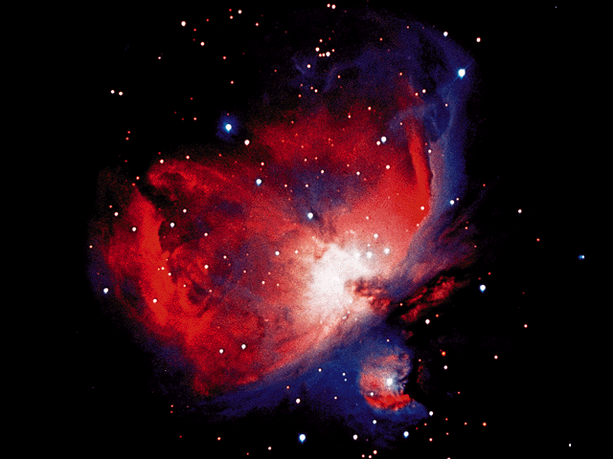
More Nebulas
As the particles pull closer together the temperature increases.
At 10,000,000º C fusion takes place and energy radiates outward through the condensing ball of gas.
Another view of Orion

Slide 17
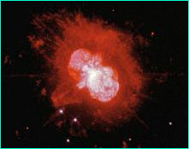
Stellar Evolution
When fusion uses up a star’s hydrogen it causes the core to heat up and the outer temperature to fall. (Life cycle of the star)
Star expands and becomes a red giant
Red Giant

Slide 18
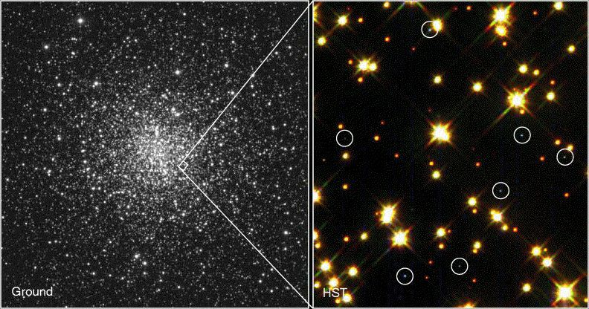
Stellar Evolution
If it is a high mass, star core continues to heat and star expands to a super giant.
As the core uses up its helium supply, the outer layers escape into space and the remaining core is white hot and called a white dwarf.
White dwarfs

Slide 19
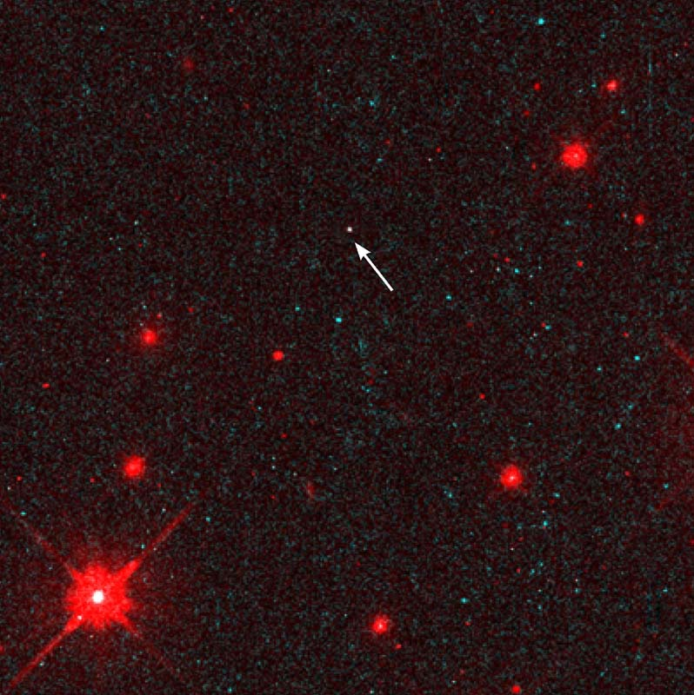
More Stellar Evolution
When no more material is left in the core it explodes into a supernova.
The star then could become either a neutron star or massive will collapse into a black hole.
Neutron Star

Slide 20
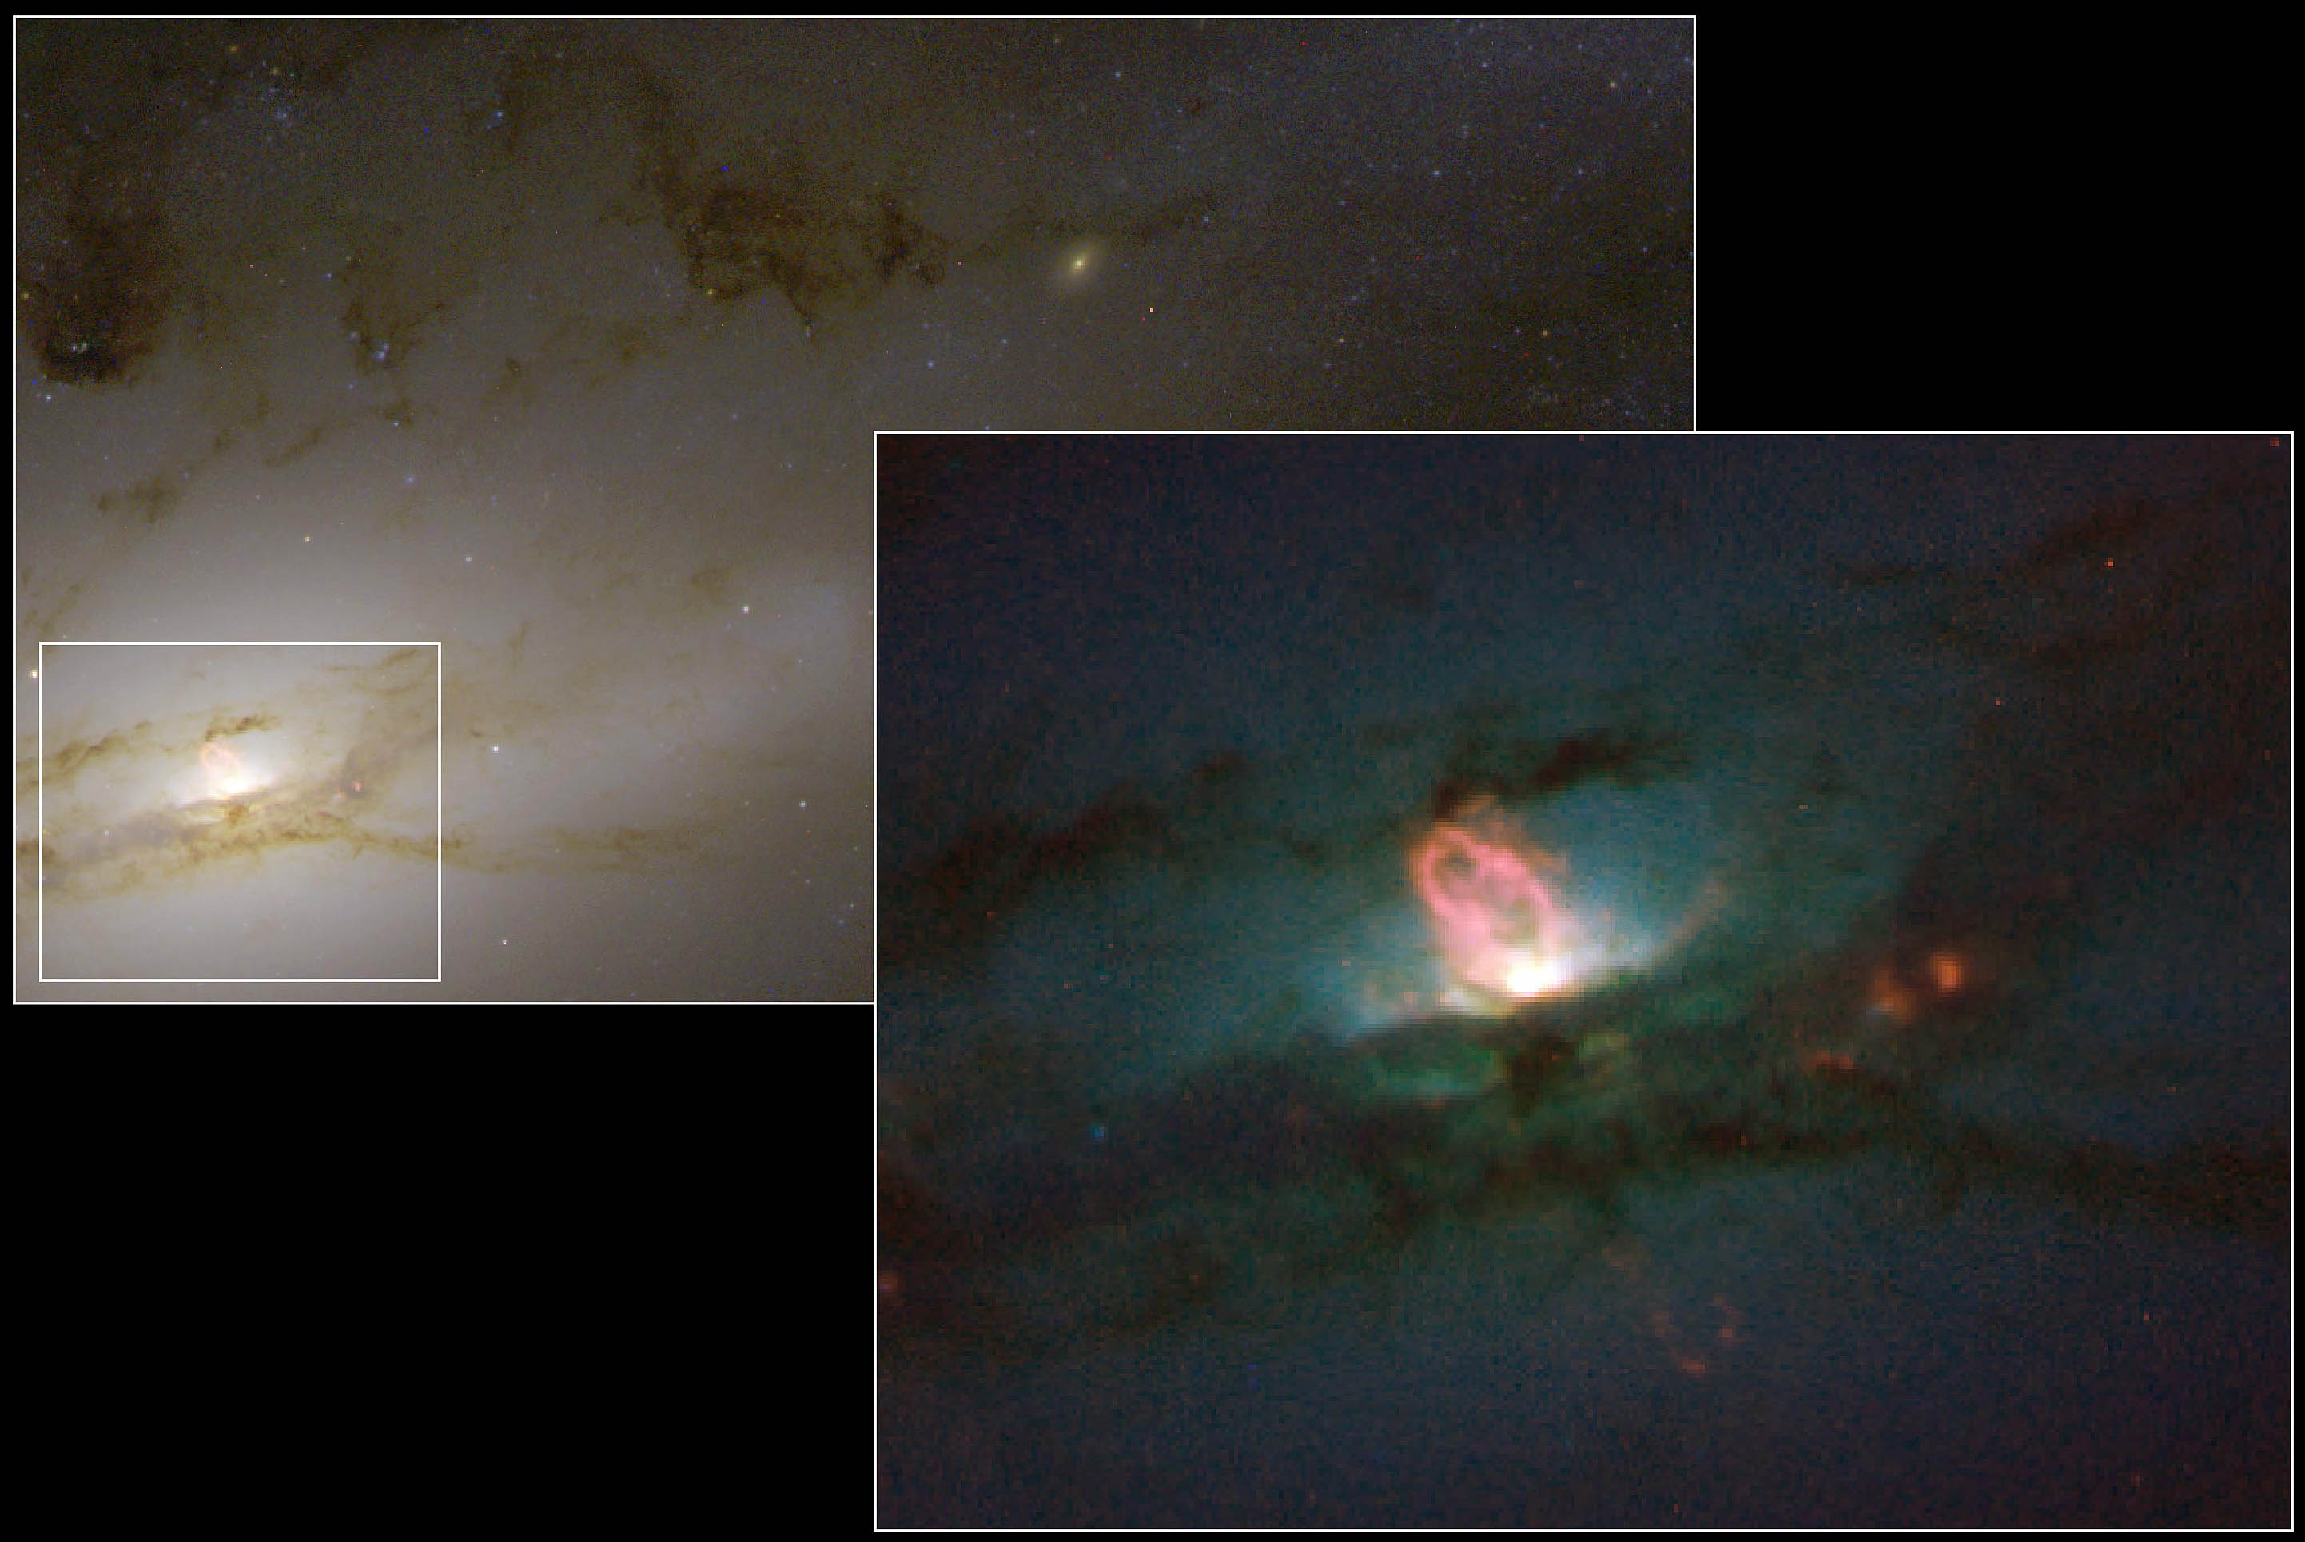
Nothing (even light) can escape the gravity of a BLACK HOLE

Slide 21
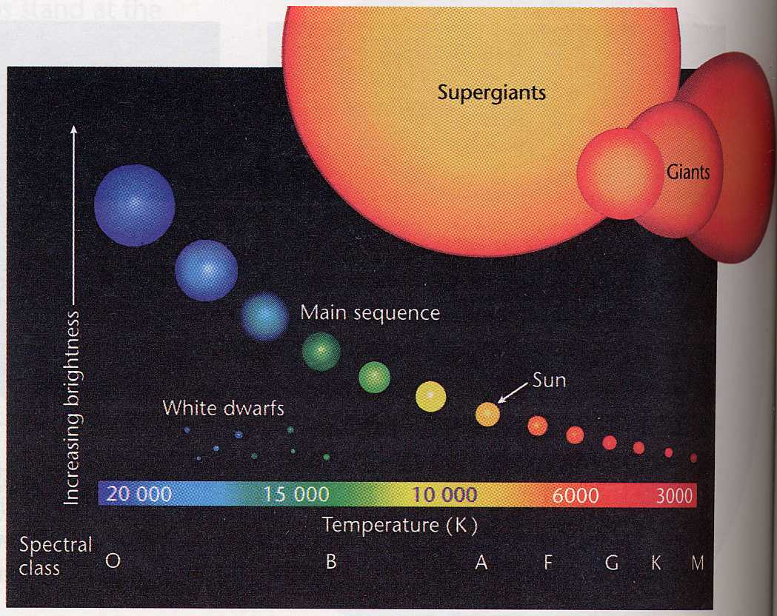
Hertsprung-Russell Diagram

Slide 23
Determining a Star’s Temperature
A star’s temperature can be determined by its color.
All objects will glow a different color when heated differently
Colors hottest to coolest: Blue/white → yellow → orange → red.

